Slide 1
Unsupervised Constituency Parsing
9th Oct 2019
Hritik Bansal
Senior Undergrad
Electrical Engineering
IIT Delhi

Slide 2
Overview
Basics
Syntactic structure in Natural language
Integrating syntactic structure in language models
Supervised vs Unsupervised learning in language models
Recent Advances
Introduction to Unsupervised Parsing algorithm
Ordered Neuron LSTM
Critical Analysis of Unsupervised Parsers

Slide 3
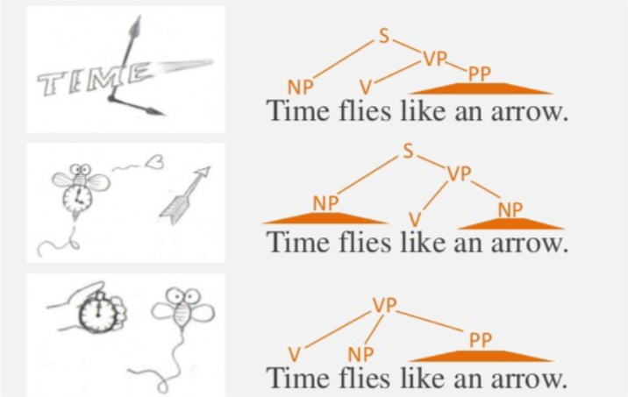
Syntactic Structure in Natural Language
Underlying structure of Language - Tree like not sequential!!
Set of rules that determine the structure is known as syntax

Slide 4
Integrating syntactic structure in Language models
Obtain hierarchical representations with increasing level of abstraction
Key feature of deep neural networks and the human brain
Capture complex linguistic phenomena
like long-term dependencies
Improve generalization and potentially decrease the training data for learning
Shen et al. 2019

Slide 5
Supervised vs Unsupervised in language models
Supervised Parsing
External agents - Expensive human experts to annotate data
Chances of error - people break rules w.r.t context - Twitter!
Treebanks of only major languages present
Unsupervised Parsing
No access to expert labelled corpora
Dependency structure to better a particular NLP application
To argue for or against poverty of stimulus
Examine cognitive issues in language acquisitions
Shen et al. 2018a

Slide 6
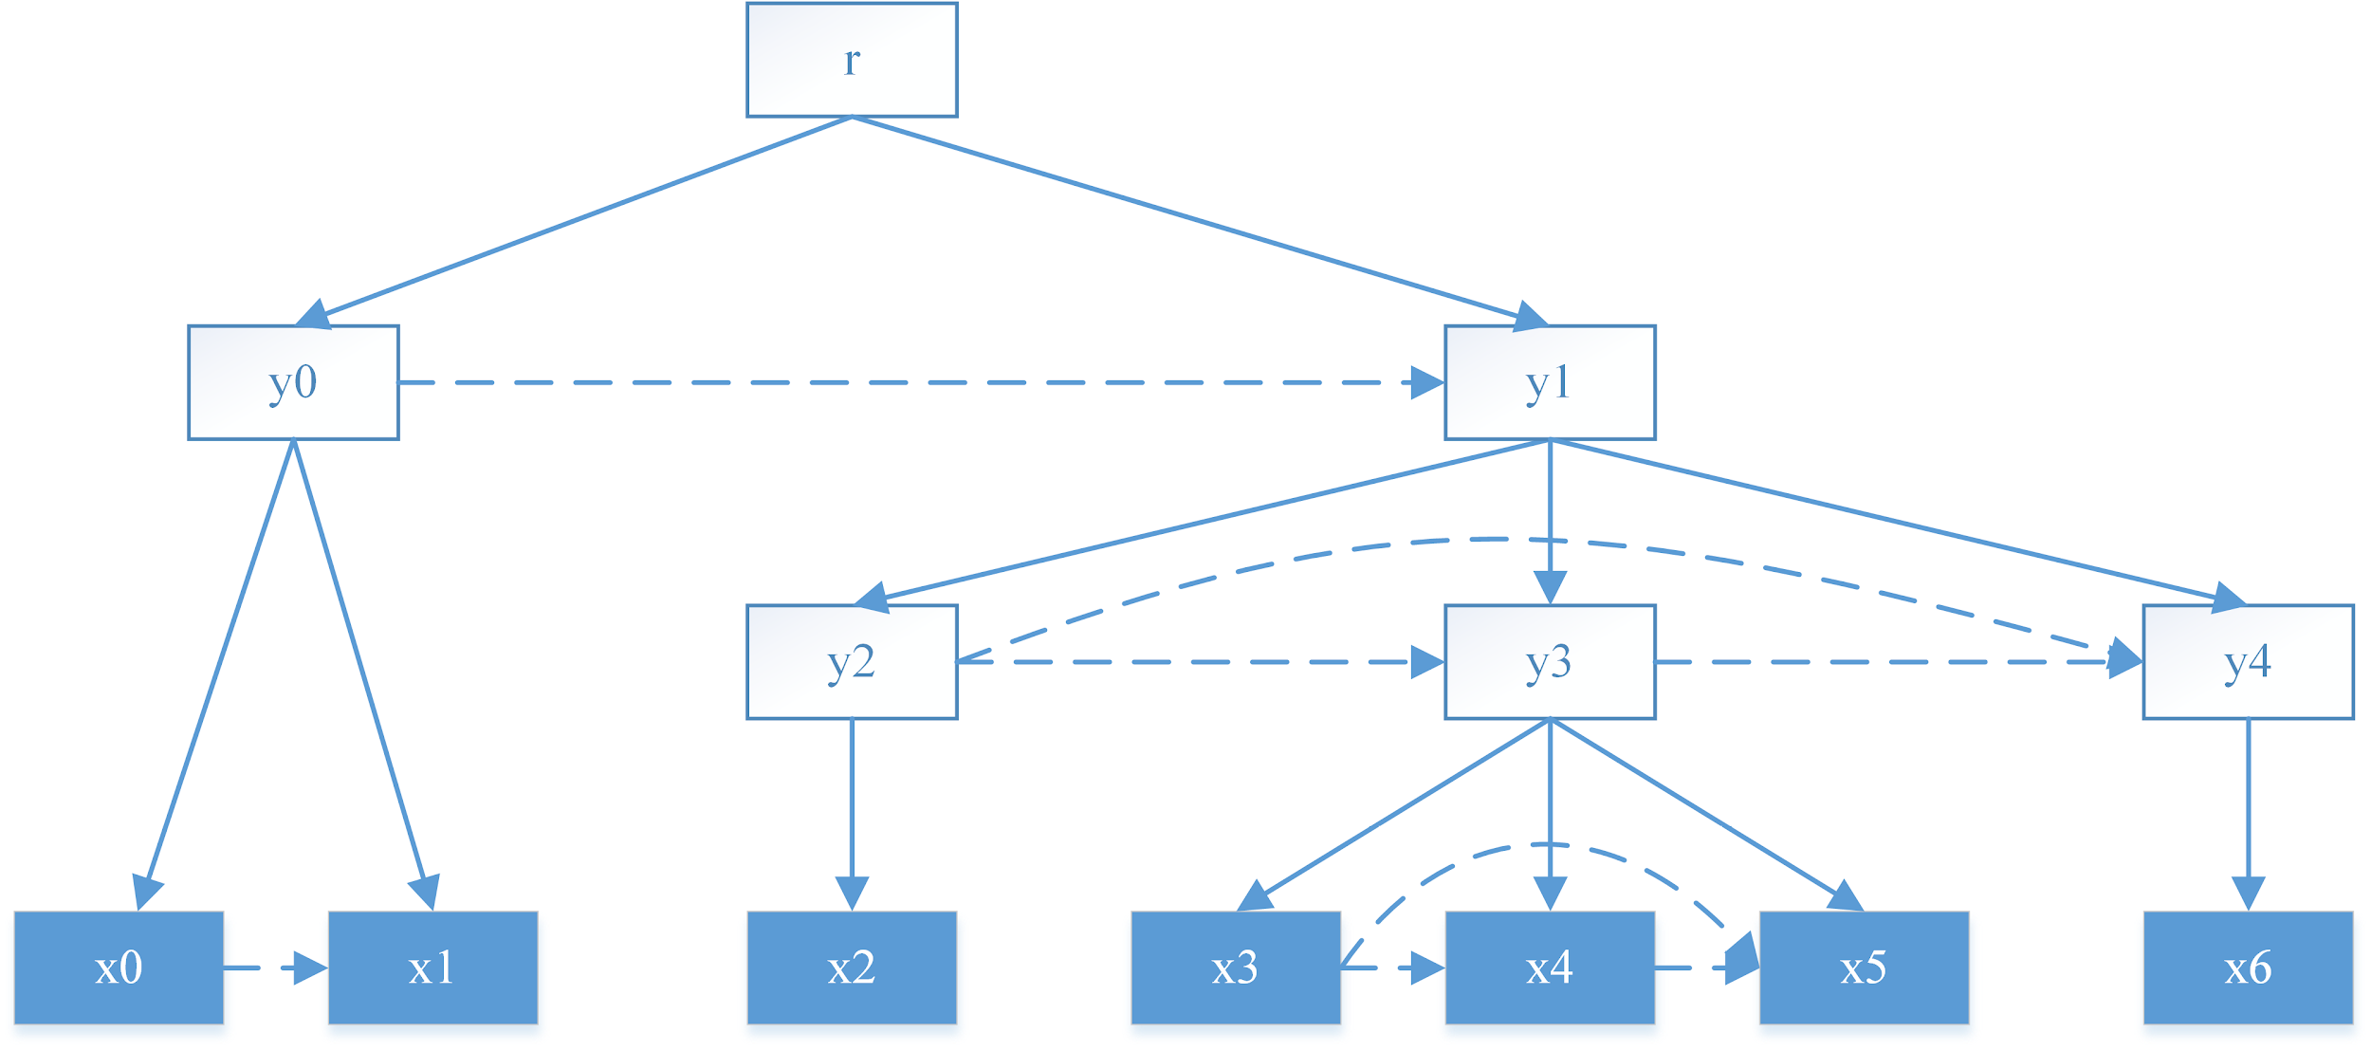
Introduction to Unsupervised Constituency Parsing Algorithm (Shen et al. 2018a)
x_{i} are the observed tokens
y_{i} are the meanings of the constituent formed by its leaves
Directly learn the tree structure?
No! - a)Challenging, requires supervision b)Not robust to ungrammatical sentences
Hidden States :) - Recurrent Neural Nets ?
But they don’t capture real dependency relations that dominate natural language
Notes:
The idea is to introduce tree structure into language models.
Recurrent models provide a convenient way to model sequential data, with the current hidden state only depends on the last
hidden state. This makes models more robust when facing nonconforming sequential data, but it
suffers from neglecting the real dependency relation that dominates the structure of natural language
sentences.

Slide 7
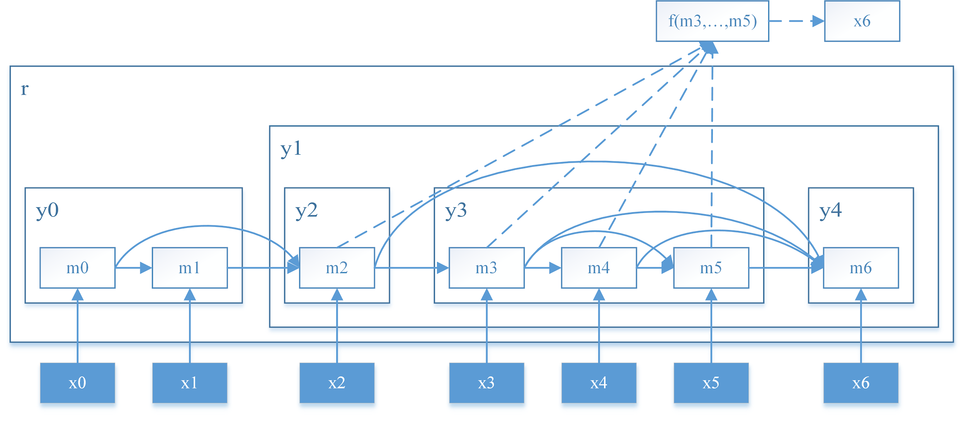
Introduction to Unsupervised Language Parsing Algorithm
Skip connections to integrate structure into recurrent neural net[Parsing-Reading-Predict Network-PRPN]
Non-leaf node y_{j} is represented by a set of hidden states {m_{i}}_{l(y)->r(y)}
Skip connections are controlled by gates g_{i}^{t} ,introduce latent variable l_{t} to represent local context of x_{t}
If x_{t} is not the leftmost child of any subtree,then l_{t} is the position of x_{t}’s leftmost sibling
If x_{t} is the leftmost child of any subtree y_{i},then l_{t} is the position of leftmost child that belongs to the left most sibling of y_{i}
Notes:
In other words, the current hidden state does not only depend on the last hidden
state, but also on previous hidden states that have a direct syntactic relation to the current one.

Slide 8


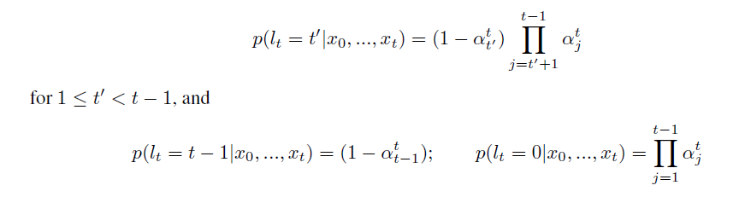
Modelling Syntactic Structure
We have to find the value of l_{t}
p(l_{t}|x₀...x_{t}) is modelled as a Dirichlet process (Multivariate Beta Distribution)
𝛼_{j}﹦1-𝛽_{j}(sampled from beta distribution)
Notes:
The skip connection will directly feed information forward, and pass gradient backward. The parent to-
child relation will be implicitly modeled by skip-connect relation between nodes.
p(lt|x0... xt) represents the probability of choosing one out of t possible local
structures that defines the conditional dependencies. If lt = t0, it means xt depends on all the
previous hidden state from mt0 to mt (t0 <=t).
Once we sample lt from the process, the connectivity is realized by a element-wise multiplication of an attention weight vector
with a masking vector gt.. In this way, xt becomes functionally independent of all xs for all s < lt.

Slide 9

Interesting Result
Expectation of g_{i}^{t} is the CDF of l_{t}
Parametrize 𝛼_{j}^{t} by a deterministic function depending on previous words
Gates are no longer discrete, and they are multiplied to attention weights

Slide 10
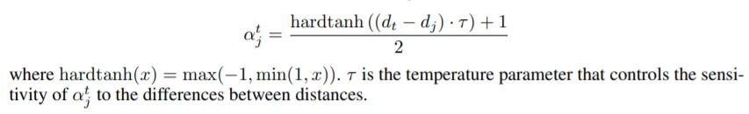
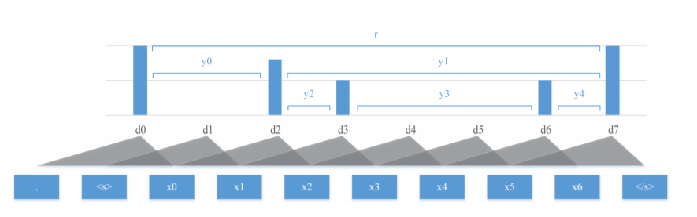
Parsing Network
For a sentence of length K, we define a set of scalar values d₀,d₁...d_{k-1},such that d_{i} is the syntactic relationship between pair of words x_{i-1},x_{i}
We would like the starting of a new constituents should have high value of 1-𝛼_{j}^{t}
The syntactic distance d_{i} can be learnt using a CNN with a sliding a window [local contextual info. ]
Notes:
The model should assign large 1- alpha_j(t) to words beginning new constituents.
While xt itself is a constituent-beginning word, the model should assign large 1 -alphatj to words beginning larger constituents

Slide 11
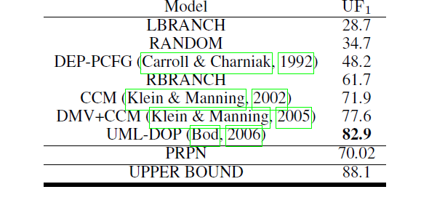
Inferring Tree Structure
The model has computed the distance between the successive words
The parsing algorithm recursively assembles tokens into constituents according to the learned distance
Arrangement in decreasing order of the distances
Separate the sentence according to the token associated with highest distance

Slide 12
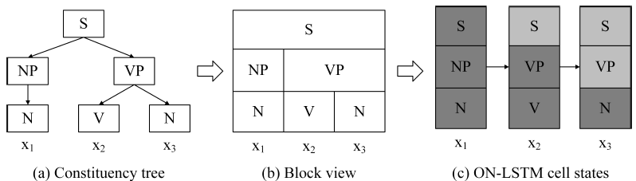
Ordered Neuron LSTM(Shen et al. 2019)
Claims that PRPN is relatively complex and difficult to train
Intuition
High ranking neuron-global information,Low ranking neuron-local context
Notes:
Figure , we illustrate how ht would contain information about all the constituents that include
the current token xt even if those are only partially observed. This intuition suggests that each
node in the tree can be represented by a set of neurons in the hidden states.

Slide 13
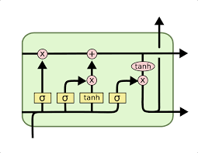
Implementation?
Gates in LSTM are independent. Makes it difficult to discern hierarchy.
Make the gates of the neuron dependent on each other by imposing a order in which they are updated

Slide 14

Implementation
Introduce a new activation function - cumax()
ĝ = cumax(...)=cumsum(softmax(...))
ĝ can be seen as expectation of binary gate g=(0,0,..0,1..,1)
Cell state has been split into 0-segment and 1-segment
Categorically R.V. d can represent the index of first 1 in g -- p(d)=softmax(...)
We can find the probability that the k-th value in g being 1
- As g_{k} is binary, it is same as E[g_{k}]
Notes:
What would be do now?
Ofcourse expectation of the gate

Slide 15

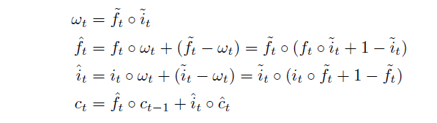
Structured Gating Mechanism
Introduction of a master forget gate and input gate
Notes:
Following the properties of the cumax() activation, the values in the master forget gate are monotonically increasing from 0 to 1, and those in the master input gate are monotonically decreasing from 1 to 0.
input xt just provides
local information that could be erased by ~ ft in the next few time steps.
The product of the two master gates !t represents the overlap of ~ ft and~i
t. Whenever an
overlap exists (9k; !tk > 0), the corresponding segment of neurons encodes the incomplete
constituents that contain some previous words and the current input word xt. Since these
constituents are incomplete, we want to update the information inside the respective blocks.
The segment is further controlled by the ft and it in the standard LSTM model to enable
more fine-grained operations within blocks
Read about the intuition - Page 5 in ON lstm paper

Slide 16

Unsupervised Constituency Parsing
D_{m} is the size of the hidden state and p_{f} is the probability distribution over different split points
Given d_{t}^{f} we can infer the tree structure using Parsing algorithm discussed earlier.
The second layer of ON-LSTM achieves state-of-the-art unsupervised constituency parsing results on the WSJ test set, while the first and third layers do not perform as well.
First and last layers may be too focused on capturing local information useful for the language modeling task as they are directly exposed to input tokens and output predictions respectively.
Notes:
To infer the tree structure of a sentence from a pre-trained model, we initialize the hidden states with
the zero vector, then feed the sentence into the model as done in the language modeling task.

Slide 17
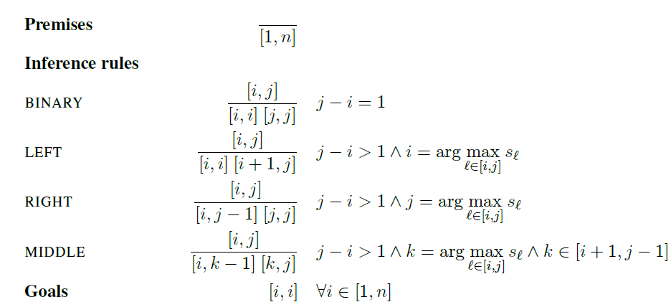
Critical Analysis of Unsupervised Parsing (Dyer et al.)
Two important contributions of this paper
Using the same parsing algorithm(Shen et al.), LSTM perform as well as ON-LSTM
The parsing algorithm is incomplete, and has a marked bias towards right branching trees.
The authors call it COO parser and define it as:
Two variants(L/R) of the parser depending upon the definition of scores s_{i} (influence on Middle Rule)
Notes:
An item [i; j] indicates a constituent spans words i to j, inclusive. Inference rules are applied as
follows: when a constituent matching the item above the line, subject to the constraints on the right is found, then
the constituents below the line are constructed.

Slide 18
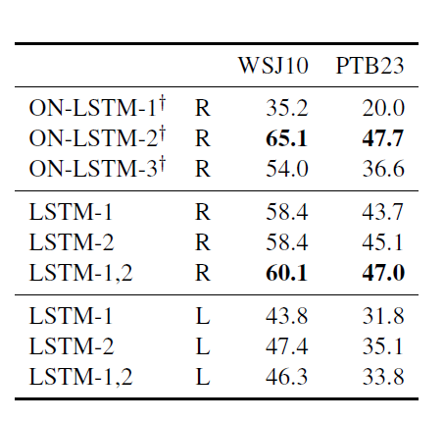
LSTM vs ON-LSTM
To find the value of d_{t}^{f} in LSTM, just sum the values in forget gates across all the layers
F1 scores of the two models are comparable
ON-LSTM model requires that a single layer be selected to compute the parser’s scoring criterion (since each layer will have a different expected forget depth), the unordered nature of LSTM forget gates means our baseline can use gates from all layers jointly
L-variant is substantially worse

Slide 19
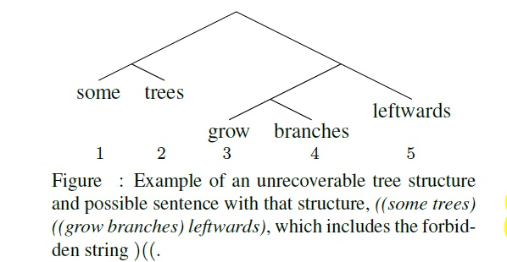
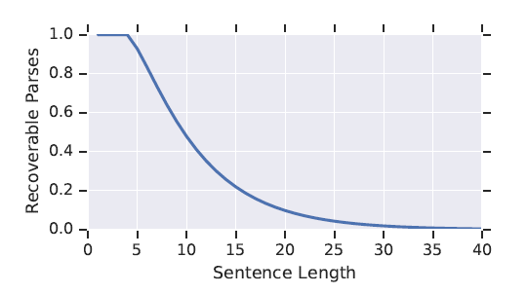
Analysis of COO parser
The R variant of parser can generate all valid binary bracketings that do not contain the contiguous string )(( . Proof by contradiction!!
The number of parses of a string of length n that is recoverable by a COO parser decreases with the length of the sentence.
Notes:
Total number of possible parses of a sentence of length is O(2^n)
ratio of the extractable parses to the number
of total binary parses- catalan number C(n-1) logarithmically converges to 0
Thus, to obtain the split between ) and (, the MIDDLE rule would have applied because of the
size constraints on the inference rules. However, as we showed in the proof of Prop. 1, after
the MIDDLE applies, a terminal symbol must be the left child of the resulting right daughter constituent,
thus we obligatorily must have the sequence )(x(, where x is any single terminal symbol. This contradicts our starting assumption.

Slide 20
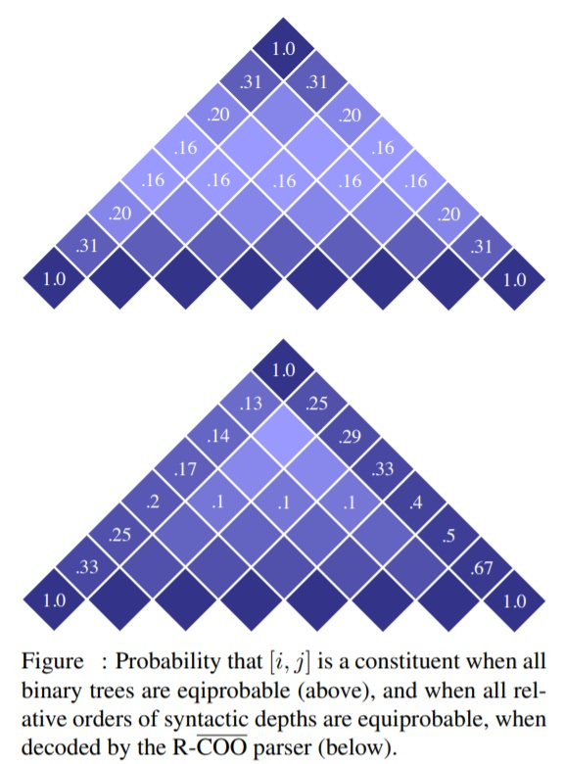
Directional Bias
R-COO parser has significant bias towards the right branching trees as clear from this experiment, which is common in English.
Notes:
This paper has drawn attention to a potential
confound in interpreting the results of experiments
using COO parsers.
https://arxiv.org/pdf/1806.04168.pdf [supervised setting ]
It is difficult for the model to give scores to transitions or word spans
-Different story in supervised setting
- a suitable linking hypothesis that connects the
Activations of a sequential language model to hypotheses
about either changes in syntactic depth
that occur from one word to the next (i.e., scoring
the gaps) or that assign scores to all spans in
a sequence.

Slide 21
Acknowledgements
Prof. Sumeet Agarwal for his constant guidance.
Gantavya Bhatt for sharing his valuable inputs.

Slide 22
ThankYou!!

